Slide 1
STALAGMITE
BY: JOSEPHINE MANU & COLETTE ICKES

Slide 2
WHAT IS IT?
STALAGMITE IS A TYPE OF ROCK FORMATION THAT RISES FROM THE FLOOR OF A CAVE, DUE TO THE ACCUMULATIONS OF MATERIAL DEPOSITING FROM CEILING DRIPPINGS.
If you take it back to the Greek word "stalassein,
" which means "to drip."

Slide 3
FORMATION
Stalagmites grow simply because of water running over and through inorganic material.
If the water that drops to the floor of the cave still has some dissolved calcite in it, it can deposit more dissolved calcite there, forming a stalagmite.

Slide 4
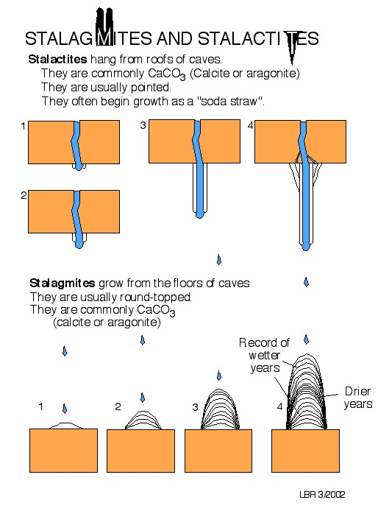
FORMATION

Slide 5
WHERE IT CAN BE FOUND?
Limestone caves
Why = Because there are mainly composed of calcite, a common mineral found in sedimentary rocks. Calcite molecules are made of calcium and carbonate ions, and are referred to as calcium carbonate.mainly composed of calcite
It can also be found in: Carlsbad Caverns in New Mexico, Timpanogos Caves in Utah, Mammoth Cave in Kentucky and Jenolan Caves and Buchan Caves in Australia.

