Slide 1
Chloroplast
By: Josephine Manu and Seth Alonso

Slide 2
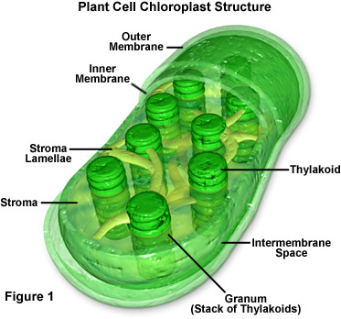
Chloroplast
Definition
-Contains the green chemical chlorophyll, which traps light for photosynthesis.
- (in green plant cells) a plastid that contains chlorophyll and in which photosynthesis takes place.

Slide 3
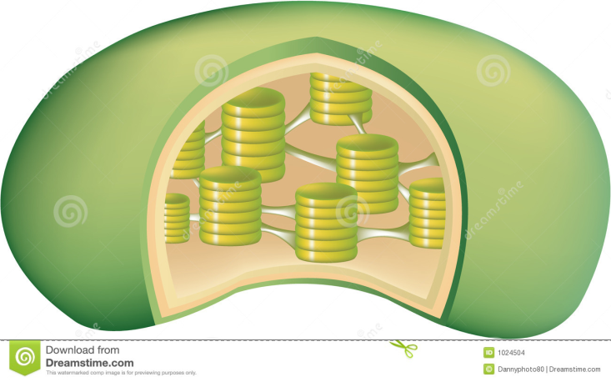
Outer membrane
-Surfaces facing the exoplasmatic lumen
-Fracture within the membrane
OUTER MEMBRANE

Slide 4
Inner membrane
-Surface facing the cytosol (stroma)
- Fracture within the membrane
INNER MEMBRANE

Slide 5
Stroma lamellae
The stroma is an area inside of the chloroplast where reactions occur and starches (sugars) are created.
Stroma

Slide 6
Granum
The stacks of thylakoids are called grana.
They are connected with an extensive system of tubules.
GRANUM

Slide 7
Intermembrane space
-This is the space that separates the outer and the inner membrane apart.
INTERMEMBRANE SPACE

Slide 8
Thylakoid
Inside the chloroplasts are stacks of discs called thylakoids. They are compared to stacks of coins within the walls of the chloroplast, and they act to trap the energy from sunlight.
THYLAKOID

Slide 9
BYE FELICIA !! (:

